Slide 1
SAGE 2020
My Contributions to “Out?”
Gerald Washington II

Slide 2
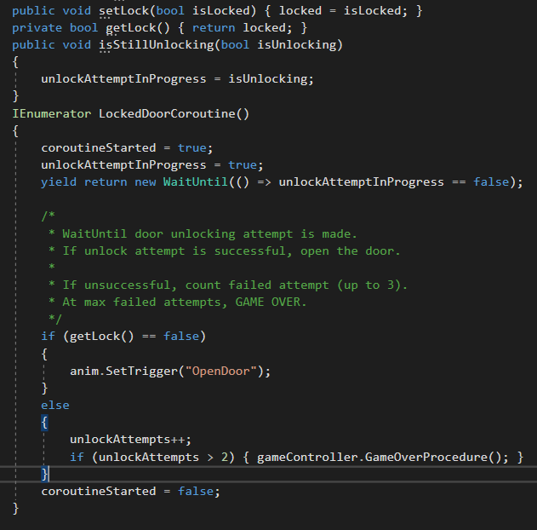
Contributions: Doors
When reaching a closed (locked) door, a coroutine starts and waits for an unlock attempt (from a Pinpad UI) to be made.

Slide 3
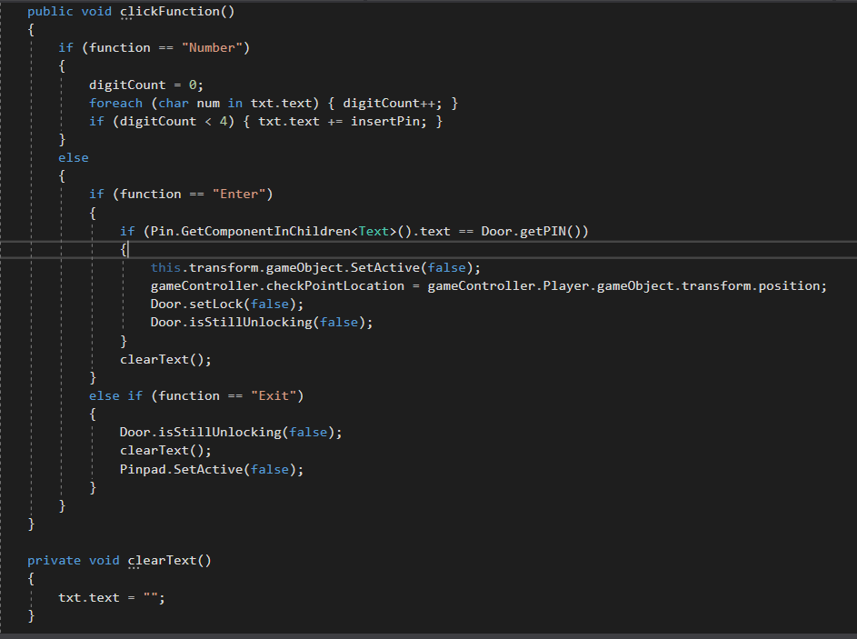
Contributions: Locks
When the PinPad UI is used, the corresponding door either gets unlocked or the number of unlocking attempts (per level) is counted.

Slide 4
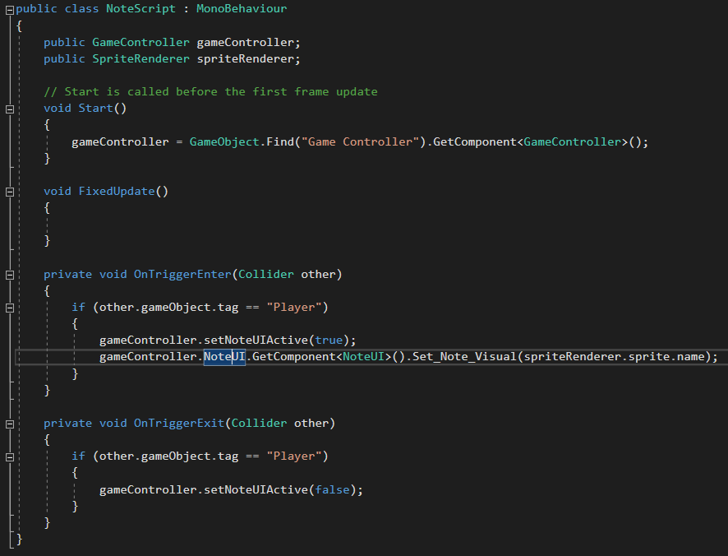
Contributions: Notes
In a way, notes act as triggers for a UI the player uses to read the note(s) content.

Slide 5
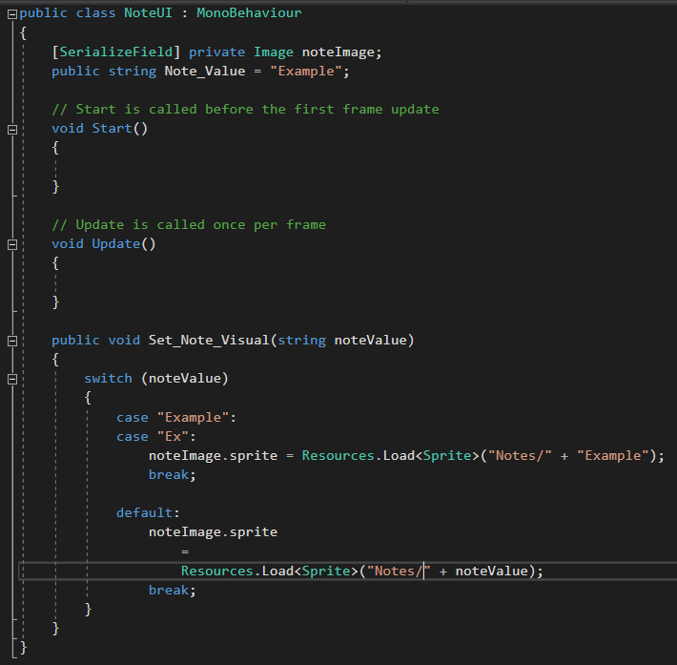
Contributions: Note UI
That UI image is meant to be changed to the image on the note the Player walks up to.

